Slide 1
The
Empty
Glass
Robi Calderaro. AAA Instructor. CCD
Notes:
To say:
Let’s do an activity…

Slide 2
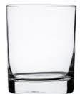
The Empty Glass
Robi Calderaro. AAA Instructor. CCD
Notes:
Ask: is the glass full or empty?
The students: empty
Click animation
Ask: how about now? is the glass full or empty?
The students: full
Click animation
Ask: and now? is the glass full or empty?
The students: full
Click animation
Ask: and… how about now? is the glass full or empty?
The students: full

Slide 3
The Empty Glass
= The important things in life, like family and health
= The next important things in life, like work and your car
= The least important things in life, like small stuff
Robi Calderaro. AAA Instructor. CCD
Notes:
Explain the animations as they are clicked:
The ping pong balls are the important things –your family, your partner, your health, your children - anything that is so important to you that if it were lost, you would be nearly destroyed.
The marbles are the other things in life that matter, but on a smaller scale. Things like your job, your house, your car.
The sand is everything else. The small stuff.
Then ask them with would happen if they filled their glass with sand/least important things in life= no time for the important ones

Slide 4
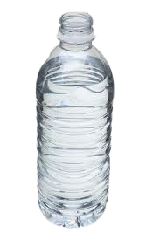
The Empty Glass
No matter how busy your life is, there is always time for a drink with friends ☺
Robi Calderaro. AAA Instructor. CCD
Notes:
To say:
So, is the glass full?
What if we added some water? (click animation, explain to the students that you can still add water to the glass)
And what does it mean? (click animation 2 and tell them that “No matter how busy life is, there is always time for a drink with friends.

